Slide 1
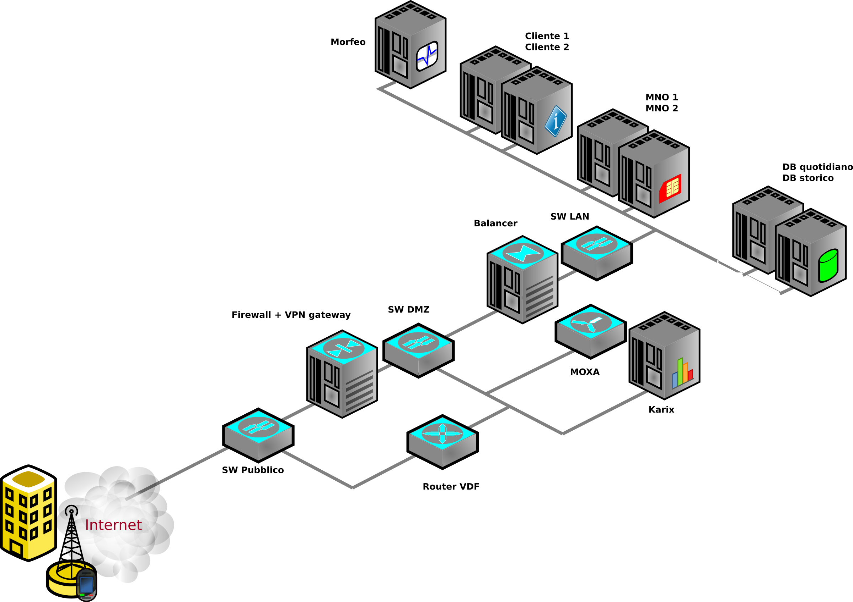
Hotel
Network
Management System
- Junaid Arshad Malik (231374)
- Anas Zahid (231336)
- Hunzla Arshad (231356)
1

Slide 2
Table of Contents:
1- Introduction.
2- Project overview.
3- Static IP assigning.
4- Dynamic IP assigning.
5- Inter VLAN.
6- Dynamic IP routing.
7- Result and Outcome.
8- Network diagram.
2

Slide 3
Introduction:
This presentation explains how a hotel network management system was designed and set up. It includes both dynamic and static IP address setups, making sure the network is fast, secure, and reliable. The system is designed to handle tasks like guest internet access, staff communication, and device connections, while also being easy to expand in the future.
3

Slide 4
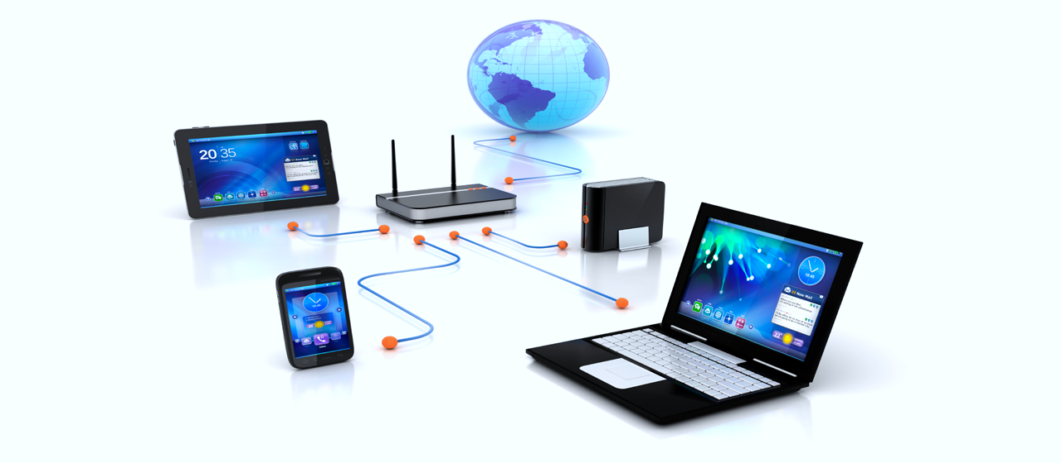
Project Overview
Objectives
Key Features
The goal was to create a robust and scalable network infrastructure for a hotel, ensuring seamless communication, efficient IP allocation, and secure inter-department connectivity.
The project incorporated static IP assignment for critical devices, dynamic IP assignment for guest devices, dynamic routing for efficient data flow, and VLANs for department-specific security.
4

Slide 5

Static IP Assignment
Explanation
Application
Servers and printers in administrative offices and departmental devices in marketing and IT were assigned static IPs.
Static IPs are manually assigned to devices, ensuring a fixed and predictable IP address.
5

Slide 6

Dynamic IP Assignment using DHCP (Dynamic Host Configuration
Protocol)
DHCP
Benefits
DHCP automatically assigns an IP address, subnet mask, default gateway, and DNS server to clients.
DHCP reduces administrative overhead, supports scalability, and prevents IP conflicts.
Application
DHCP was implemented on each router to provide IP addresses to guest devices and employee laptops.
6

Slide 7



Inter-VLAN Communication
VLANs
Security
VLANs segregate network traffic to isolate different departments.
VLANs enhance security while maintaining necessary connectivity between departments.
7

Slide 8
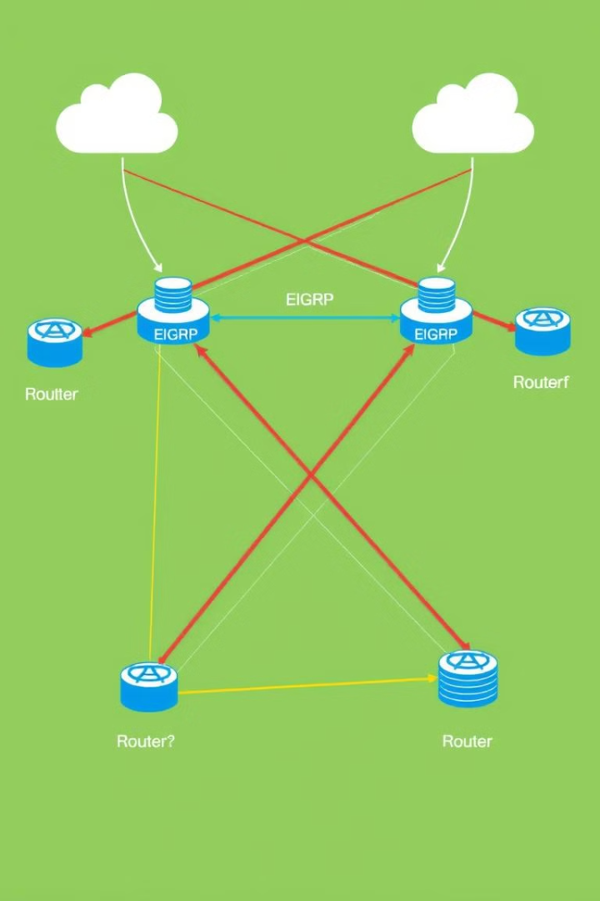
Dynamic IP Routing Using EIGRP (Enhanced Interior Gateway Routing Protocol)
1
EIGRP
EIGRP is a protocol designed for high-performance dynamic routing.
2
Application
EIGRP was used to interconnect the routers on different floors, enabling dynamic routing for optimal path selection.
3
Benefits
EIGRP provides efficient and loop-free routing updates, ensuring high availability and minimal downtime.
8

Slide 9
Results and Outcomes
1
Efficient IP Allocation
DHCP ensures optimal utilization of the IP address pool, dynamically assigning addresses to a wide range of devices.
Improved Network Security
2
VLAN segmentation restricted access to sensitive resources, ensuring that data specific to marketing and IT.
High Availability
3
The use of EIGRP dynamic routing provided redundancy and minimized downtime, ensuring seamless data flow during link failures.
Scalability
4
The network was designed to handle additional departments or devices with minimal reconfiguration.
9

Slide 10

Network Diagram
1
Core Routers
2
Switches
3
Devices
Three routers form the backbone of the network, connecting different floors and critical departments.
Switches manage departmental networks and facilitate inter-VLAN communication.
Includes servers, printers, laptops, and guest devices.
4
VLAN Segmentation
5
Routing Protocol
VLANs to segregate traffic: VLAN 10 for Marketing, VLAN 20 for IT.
EIGRP ensures dynamic routing between routers for high performance and fault tolerance.
10

Slide 11
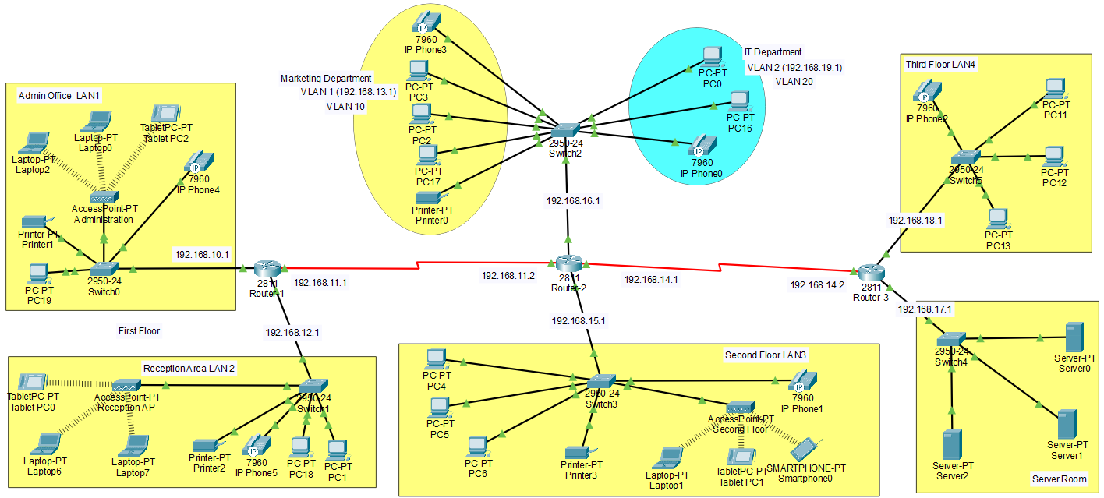
11

Slide 12



